Slide 1
FBA for Jacob
By: Kristen Janowicz
Plymouth State University
Behavior Disorders in School Age Children
Winter 2014
Dr. Lebrun

Slide 2
Case Profile
Name: Jacob*
Gender: Male
Age: 6
Grade: First
Parents: Jacob’s parents are divorced and Jacob’s mother has full custody of him. Jacob’s mother has a boyfriend who is in and out of the picture.
Schooling History: Jacob’s Developmental Delay has prevented him from learning among his peers in the general education classroom for subjects Reading and Math. Jacob’s speech delay also causes peers and teachers to question his statements in order to clarify what he is trying to say. Jacob also has a diagnosis of ADHD. He is an extremely energetic student who craves attention, and becomes discouraged during difficult tasks, making it extremely difficult to complete any task on his own.
Note: Name has been changed.

Slide 3
School Description
School Name: Campton Elementary School
Location: Campton, NH
Classroom Teacher: C.W.
Other educators involved:
-Special Education Case Manager: K. S.
-Speech Pathologist: B.C.
-Special Education Intern: Kristen Janowicz
-Paraprofessional: M.J.

Slide 4
Classroom Description
Resources Available in Room:
-Computers, books, scrap paper, pencil sharpener
coloring tools, number lines, hundreds charts, base ten
blocks, etc.
Classroom Rules/Routines:
-The routine/schedule of the day is always posted in the room
so all children know what it coming next. Routines are
consistent. Children in Mrs. W’s know the class expectations well
and know to treat their peers and teachers with respect.
Environmental Noise:
-Mrs. W’s classroom is typically quiet, but can be noisy during
whole and small group activities.
Environmental Lighting:
-There are several windows in the room that are used for natural lighting.
There are typically one or two other sets of lights on, depending on the
activity. Mrs. W’s classroom’s lighting is usually bright enough, but not
overwhelming.
Environmental Temperature:
-Mrs. W’s room is usually a comfortable temperature.
Environmental Space:
-There is space for movement in the middle of the room, desks for each student, tables for
centers as well as space for classroom resources.
Environmental Mobility:
It classroom setup provides for easy mobility around the room for all students.
Environmental Groupings:
Groupings during center time differ each week. Reading groups are based on skill level.
Behavior Management Methods:
There is a “Take a break” chair in the room for behavior management, but Mrs. W hardly
has to use the chair due to the classroom expectations and atmosphere she has developed.
Teaching Style:
Mrs. W differentiates her teaching methods to meet the needs of all of her students. She
wants to see her students succeeds and is dedicated to ensuring success among her
students. Mrs. W is caring, understanding, yet firm with high expectations for each student.

Slide 5
Classroom Map
Windows
Mrs. W’s Desk
Bookshelf
Computers
Projector Screen
Reading Table
Table
Desks
Rug
Desks
Table
Desks
Cubbies
Cubbies

Slide 6
Testable Hypothesis
Context
Mrs. W’s classroom during work time (Centers)
Pull out time in speech room for Reading Intervention
Triggers
Working on assignments that are too difficult for Jacob
Working on intervention that is uninteresting & difficult for Jacob.
Problem Behavior
Jacob travels around the classroom, finding other things to do, plays with objects, talks to peers, sits by the window, etc.
Refuses to do work, puts head down, gets out of seat and goes to the window, turns body around, etc.
Get or Avoid
Avoid doing school work
Avoids doing uninteresting and difficult work
POSITIVE BEHAVIOR SUPPORTS
Seat Jacob close to Mrs. W in order to receive praise for on-task behavior, which will encourage Jacob to stay on task and seek help if needed.
Reinforce Jacob for completion of Reading Intervention with an activity he is interested in (iPad).
NEW BEHAVIOR
Jacob will be productive when working during center time and will move forward through difficult tasks.
Jacob will stay motivated during Reading Intervention in order to reach iPad reward.
CONSEQUENCES
Jacob will be able to stay on-task during center time, as well as motivated to complete difficult tasks.
Jacob will participate in Reading Intervention without refusal and will be rewarded with a turn on the iPad.
HYPOTHESIS: _____Jacob_____________ engages in _____work refusal______________ when
______working on reading skills._________This occurs in order to avoid_doing “boring”/difficult work. This
behavior is more likely to occur when _pulled out for Reading Intervention.

Slide 7
Function Based Interventions: Change Context
Structure the environment to facilitate task completion.
Reduce distracting stimuli by seating student away from distractions.
Seat student near teacher during work time.
Provide Jacob with task options so he feels in control.
Hook Jacob by relating tasks to his subjects of interest.
Chunk/break up tasks.

Slide 8
Function Based Interventions: Prevent Triggers
Provide tasks for Jacob that aren’t too difficult in order to avoid feeling defeated.
Create tasks that Jacob will find interesting in order to maintain attention.
Provide Jacob with a reward to work towards each work time. (iPad)
Provide Jacob with an activity checklist so he knows how many he has left to complete until his reward.
Praise Jacob when he is working on assignment, staying focusing during intervention, etc.

Slide 9
Intervention to Teach New/Replacement Behavior
Introduce Jacob to the “Activity Checklist.”
-Jacob will be provided with a daily checklist during his reading intervention. Jacob will use the checklist to monitor his completion of tasks.
Introduce the iPad reward for time on task/task completion.
-When Jacob has checked everything off on the “Activity Checklist”, he will receive a turn on the iPad to play a game.
Provide Jacob with positive feedback/praise when on task.
-When Jacob is remaining on task and working through difficult tasks without negative comments, he will receive appraisal from myself or classroom teacher.

Slide 10
Interventions to Maintain Positive Behaviors
Jacob will be reinforced for on-task behaviors and task completion with a turn on the iPad.
Jacob will receive verbal recognition from teachers when he is displaying positive behaviors in order to help him maintain motivation during assignments.
Jacob will self-monitor through the “Activity Checklist.”
Jacob will receive a choice of games, so he can feel in charge and choose a game that interests him.

Slide 11
Interview Summary #1
Note: Please view interview in Appendix
When interviewing Jacob’s teacher, she expressed concern regarding his inattentiveness and off-task behaviors. Jacob struggles to maintain focus in the classroom and avoids doing many tasks that are difficult for him. Jacob’s family is very important to him and he is interested in the outdoors. Jacob dislikes subjects Reading and Math. Jacob’s problem behaviors are displayed on a daily basis in the general education classroom. Right now, Jacob responds well to verbal praise, but she would like for him to learn coping skills, find strategies to help him focus and suggested that he may be willing to work for a reward.

Slide 12
Interview Summary #2
Note: Please view interview in Appendix
When interviewing the intern who conducts an intervention with Jacob, she described Jacob as an active child who is considerate of others. He enjoys bike riding and outside play, as well as family time. She explained that Jacob is consistently off-task due to a lack of attention and negative outlook towards difficult assignments. Jacob’s problem behaviors occur in both the general education setting, as well as the special education setting. Jacob requires assistance in staying on task and would benefit from additional support in academic areas and an increase in opportunities for success.

Slide 13
ABC Model
Date: 12/17/2013
Time: 8:32-8:44
Instructional Activity: Reading Intervention
Antecedent | Behavior | Consequences
Jacob sat down at the table for R.I. time with me. Jacob participates in intervention for roughly two minutes. Student returns to the table and participates | Student complained, “I don’t want to do this-it’s boring”, followed by, “I’m not doing this.” After one task is completed, Jacob gets out of seat and walks to the window. Students makes negative comments throughout the remainder of intervention. | Jacob is encouraged to stay positive, I explain this is important so he can learn to read. Intern (me) told student to come back over and suggested maybe during gym time would be a better time to complete the intervention. Only half of the intervention was completed-we needed to finish the rest the following day.

Slide 14
ABC Model
Date: 12/17/2013
Time: 10:33-10:45
Instructional Activity: Reading Centers
Antecedent | Behavior | Consequences
Jacob is asked by classroom teacher to check center schedule. Students retrieves spelling sheet with his words. | Jacob checks schedule and walks over to a bucket of balls, which he starts playing with. Jacob says, “This too hard” and gets out of his seat and walks over to the window. | Teacher asks students what center he is supposed to be at and tells him to get there now. Teacher picks up Jacob’s spelling sheet, walks over to the window and tells him to come sit with her at the reading table. Jacob remains on task for the rest of the observation period.

Slide 15
ABC Model
Date: 12/18/2013
Time: 8:41-8:52
Instructional Activity: Speech room for Reading Intervention
Antecedent | Behavior | Consequences
Time for Reading Intervention in speech room. One minutes is up-time to start intervention. Jacob is told to come back over. | When Jacob enters the room, he walks over to the window and starts playing with the blinds. Jacob remains at the window and says, “I’m looking for Mom.” | Jacob is told that he has one minute to look out the window, and then it’s time to come over to work. Jacob is reminded again that his minute is up-he will see Mom this afternoon. Jacob eventually comes back over for intervention.

Slide 16
Observation One
Interval | Off task | Vocalizing | Talks to Teacher/Peer | Plays with Objects | Out of Seat | Negative Behavior | Teacher commands | Other
1a. | X |  |  | X | X
1b. | X |  |  | X | X |  | X
2a.
2b. |  | X | X
3a. |  | X | X
3b.
4a.
4b.
5a. | X |  |  |  | X
5b. | X |  |  |  | X
6a. | X |  |  |  | X
6b. | X |  |  |  | X
7a. | X |  |  |  | X |  | X
7b.
8a.
8b. | X |  |  |  |  | X
9a. | X |  |  |  |  | X
9b. | X |  |  |  |  | X
10a. | X |  | X
10b. | X |  | X

Slide 17
Observation One continued…
Observation One was conducted on a Thursday, December 11th during center time. During this time, students are expected to work independently, or with group members, depending on the task.
The data shows that Jacob was off-task 60% of the time, with 35% of the time being out of his seat. Jacob’s task required him to sit at his own seat to work individually., which he found to be quite challenging.

Slide 18
Observation Two
Interval | Off task | Vocalizing | Talks to Teacher/Peer | Plays with Objects | Out of Seat | Negative Behavior | Teacher commands | Other
1a. | X
1b. | X |  |  |  |  |  | X
2a. | X |  |  |  | X
2b. | X |  |  | X | X |  | X
3a. | X |  |  | X | X
3b. | X |  |  |  |  | X
4a. | X |  |  |  |  | X | X
4b. | X |  |  |  |  | X
5a. | X |  |  |  |  | X | X
5b. |  |  | X
6a. |  |  | X
6b. |  |  | X
7a. |  |  | X
7b. |  |  |  |  |  | X
8a. |  |  |  |  |  | X
8b. |  |  |  |  |  |  | X
9a. |  |  | X
9b. |  |  | X
10a. |  |  | X
10b. |  |  | X

Slide 19
Observation Two continued…
Observation Two took place in the speech room, in a one-on-one setting on the morning of December 12th, 2014. Jacob made comments about being tired that morning due to a lack of sleep.
Jacob spent 50% of the intervention time talking to me random topics/interests. Jacob also made several negative comments regarding the task.

Slide 20
Observation Three
Interval | Off task | Vocalizing | Talks to Teacher/Peer | Plays with Objects | Out of Seat | Negative Behavior | Teacher commands | Other
1a. | X |  | X |  | X
1b. | X |  | X |  | X
2a. | X |  | X |  | X
2b. | X |  | X |  | X
3a. | X |  |  |  | X
3b. | X |  |  | X | X
4a. | X |  |  | X | X |  | X
4b.
5a.
5b. | X
6a. | X
6b. | X |  |  |  | X
7a. |  |  |  |  | X
7b. |  |  |  |  | X |  | X
8a.
8b.
9a. | X |  |  | X
9b. | X |  |  | X
10a. | X |  |  | X
10b. | X |  | X

Slide 21
Observation Three continued…
This observation was conducted mid-morning on December 12th during center time. Jacob was assigned an art activity at a group table.
Jacob spent 70% of this time period off-task. Jacob was also out of his assigned seat 55% of the time. Jacob had a difficult time completing the task due to the time he spent away from the task.

Slide 22
Functional Behavioral Assessment: Part 1
Description of Behavior (No. ____): Jacob is a hyper-active student who has a difficult time maintaining focus during assignments that are not interesting to him and struggles to persevere through challenging tasks. When Jacob would prefer not to do an assignment due to the interest level or level of difficulty, he spends more than 50% of his time off-task in both classroom and pull-out settings. When Jacob is displaying off-task behavior, he is usually out of his sitting, sitting at the window. Other times, Jacob refuses to do his work and shuts down. Shutting down can be explained as putting his head down or turning his body around to avoid looking at the person and/or task. Jacob also makes negative comments throughout independent or intervention work time.
Setting(s) in which behavior occurs: These behaviors occur in the general education classroom, which have been documented during center time. These behaviors also occur (more often) during Jacob’s reading intervention, which is in a one-on-one setting in the speech room.
Frequency: Jacob’s behaviors occur daily, multiple times throughout the day.
Intensity (Consequences of problem behavior on student, peers, instructional environment): Jacob’s inability to maintain focus and persevere through challenging tasks is hindering his academic success. Jacob is unable to learn to the best of his ability due to his lack of attention and tendency to give up during difficult tasks. When Jacob is participating in off-task behaviors, his peers also become distracted, which negatively effects their learning. Time reprimanding Jacob takes away from instruction time in the classroom and during pull-out services.
Duration: Jacob has displayed challenges with maintaining attention since Kindergarten (last year). Since kindergarten, Jacob has found many academic tasks difficult, but used to be able to persevere through them with support and praise from teachers. Since the beginning of first grade, Jacob’s inability to maintain focus in school has increased and his perseverance has diminished. It’s suggested that this is due to his Developmental Delay, ADHD and his challenging, inconsistent home life.
Describe Previous Interventions: Jacob has received extra help from classroom teachers and the special education teacher in the subjects of reading and math since Kindergarten. This year (first grade) was the first time academic interventions came into place. A behavioral intervention was not used previously.
Educational impact: Jacob’s behaviors are negatively impacting his ability to learn in the general education setting, as well as in the special education setting. Jacob’s difficulties maintaining attention cause him to have an abundance of incomplete tasks, as well as a lack of knowledge gained from lessons and classwork. Jacob’s negative attitude towards tasks that are too challenging or uninteresting also cause a lack of completed tasks and an unexceptional learning experience in multiple settings.

Slide 23
Functional Behavioral Assessment: Part 2
Function of Behavior (No.1___): Specify hypothesized function for each area checked below.
◻ Affective Regulation/Emotional Reactivity (Identify emotional factors; anxiety, depression, anger, poor self-concept; that play a role in organizing or directing problem behavior): Jacob is constantly concerned about his family members, especially his mother. During periods of homelessness, Jacob is spends most of his time worrying, whether it be about his family, eating that night, or where they are all going to sleep. This results in a saddened emotional state. Jacob displays a poor self-concept only when tasks are too difficult for him and makes comments similar to, “I can’t do this.”
◻ Cognitive Distortion (Identify distorted thoughts; inaccurate attributions, negative self-statements, erroneous interpretations of events; that play a role in organizing or directing problem behavior): Negative self-statements that Jacob makes are usually along the lines of, “I can’t do this”, or “This too hard for me.” These negative statements result in a longer delay of completely the task, or task refusal. Jacob has a chaotic home life that sometimes causes erroneous interpretations of family-life events.
◻ Reinforcement (Identify environmental triggers and payoffs that play a role in organizing and directing problem behavior): Jacob is triggered in noisy environments, especially when individual focus on a task is required. Jacob responds well to praise from teachers and peers, as well as rewards that involve participating in a task of interest. Jacob excels in environments where constant movement is permitted (P.E.).
◻ Modeling (Identify the degree to which the behavior is copied, who they are copying the behavior from, and why they are copying the behavior): Jacob doesn’t show signs of copying behaviors from peers. His sister also receives services in the speech room, where she has been observed displaying similar behaviors, such as negative comments during difficult/uninteresting tasks. Jacob’s language is copied from his mother and siblings.
◻ Family Issues (Identify family issues that play a part in organizing and directing problem behavior): Jacob has two older sisters who are also diagnosed with disabilities. Jacob’s father is not in the picture, but his mother’s boyfriend (off and on) steps in as a father when available (sometimes out of the picture due to drug and alcohol related issues). Jacob’s family has also experienced periods of homelessness throughout this school year. Jacob has a chaotic family/home life, which causes him to constantly worry about his family, especially his mother. Jacob’s worries add to his inability to focus on his learning.
◻ Physiological/Constitutional (Identify physiological and/or personality characteristics; developmental disabilities, temperament; that play a part in organizing and directing problem behavior): Jacob is diagnosed has Developmentally Delayed. Jacob also has a medical diagnosis of ADHD. Jacob’s DD causes him to feel defeated during certain tasks that are difficult. His ADHD, although medicated, adds to his challenge of paying attention in all academic settings.
◻ Communicate need (Identify what the student is trying to say through the problem behavior): Jacob is trying to say through his problem behavior, “I don’t understand” and “I’m not interested.”
◻ Curriculum/Instruction (Identify how instruction, curriculum, or educational environment play a part in organizing and directing problem behavior): When Jacob is expected to complete tasks on his own, he struggles with attention as well as motivation. When the environment is loud, Jacob loses focus easily. Jacob completes and learn from tasks that are completed with a teacher, as well as those that interest him.

Slide 24
Develop Hypothesis About Behavior
Jacob engages in off-task behaviors when he views tasks as too difficult or boring. Jacob’s off-task behaviors usually involve him getting out of his seat to walk around the room, touch/play with objects, or sit by the window. Jacob is inattentive during these types of tasks and would prefer to engage in off-task behaviors or conversation instead of his work. These behaviors are more likely to occur during center time (general education classroom) and during his reading intervention.

Slide 25
Feature 1 Skill Set Write In Response
Develop a Behavior Pathway and Summary Statement | 1. Define problem behavior in observable and measurable terms. | Jacob displays inattentiveness and a lack of motivation to complete tasks that aren’t interesting to him or are too difficult. His inattentiveness and lack of motivation are displayed through off-task behaviors (walking around, out of seat, playing with objects, etc.) and negative comments (“I can’t do this.”).
 | 2. Describe problem behavior in terms of frequency or rate and intensity. | Jacob’s problem behaviors occur on a daily basis, repeatedly throughout the day. Jacob’s inability to maintain focus and persevere through challenging tasks is hindering his academic success. Jacob is unable to learn to the best of his ability due to his lack of attention and tendency to give up during difficult tasks.
 | 3. Identify immediate triggering antecedent or, if possible, distant setting events. | Jacob’s triggers include being assigned to a difficult task or a task that he is uninterested in. His triggers are heightened in noisy environments with a lack of adult attention.
 | 4. Determine if the problem behavior occurs in one or more routines. | Routine 1: Problems behaviors occur in the general education classroom, during center time. Routine 2: Problem behaviors occur in the speech room during reading intervention time.
 | 5. Identify possible function of behavior or maintaining consequence events for each problem routine. | Routine 1: Problem behaviors occur in order to avoid difficult tasks. Routine 2: Problem behaviors occur in order to avoid difficult and/or boring tasks.
 | Develop complete summary statement which includes problem behavior, problem routine, triggering antecedents and function or maintaining consequences. | Jacob engages in off-task behaviors and work refusal in general education settings, as well as during his pull-out intervention, when presented with tasks that are too difficult or uninteresting to him. This results in Jacob experiencing feelings of defeat and an incompletion of assignments/tasks.

Slide 26
Feature 2 Skill Set Write In Response
Developing Replacement Behavior Based on Function | 1. Identify student strengths and interests to inform reinforcement and behavior plan strategies. | Jacob is caring individual who enjoys playing games and hands-on experiences. Jacob has verbalized an interesting in playing on his mother’s iPhone, which hints at an interest in technology. Jacob enjoys bike riding, animals, trucks, and the outdoors.
 | 2. Identify short-term replacement behavior(s) for the problem behavior for each problem routine. | Routine 1: Provide Jacob with shortened tasks (chunk assignments) in order for him to maintain focus on one shortened assignment at a time. Routine 2: Provide Jacob with positive feedback when he demonstrates on-task behaviors and perseveres through difficult activities.
 | 3. The short-term replacement behavior(s) are matched to the apparent function of the problem behavior for each routine. | Routine 1: Jacob will self-monitor through an activity check-list in order to increase time on task/completion of tasks. Routine 2: Jacob will be rewarded with a turn on the iPad after he completes his activity check-list.

Slide 27
Feature 3 Skill Set Write In Response
Identify Strategies For Behavior Support Plan (BSP) | 1. Select strategies that minimize impact of setting events or make triggering antecedents irrelevant or ineffective. | Provide Jacob with preferential seating near adult in the general education setting, break up tasks for Jacob and provide Jacob with positive verbal recognition when displaying appropriate behaviors. Create tasks and/or rewards that are interesting to the student.
 | 2. Select strategies that teach student skills that make problem behavior less efficient and effective including the replacement behaviors. | Teach Jacob to self-monitor during tasks through check-list system in order to stay on task and increase task completion. Teach Jacob with coping skills to deal with tasks that seem too difficult for him in order to stay motivated to complete tasks.
 | 3. Select strategies that make the maintaining consequences for problem behavior less effective – minimize the impact of inadvertently reinforcing the problem behavior. | Provide Jacob with a break (short walk around the school) before beginning a challenging assignment.
 | 4. Select punishment strategies that reduce the likelihood the problem behavior will reoccur. | Jacob will not be able to check off any assignment that he did not complete. If Jacob does not complete all of his tasks, he will not receive a game turn on the iPad.
 | 5. Select reinforcement strategies that make replacement or desired behaviors more effective. | When Jacob has completed all of his tasks, he will receive a turn on the iPad. This will motivate him to stay on task and complete his work since he will now have something to look forward to.
 | 6. The reinforcement strategies include student’s strengths and interests or things the student finds reinforcing. | Jason will be able to take part in a preferred activity (game on the iPad-his choice!), hands-on activities, and teacher praise.
 | If necessary, develop emergency procedures if behavior escalates. | Unnecessary

Slide 28
Feature 4 Skill Set Write In Response
Develop a Plan to Monitor Progress | 1. Develop observable and measurable outcomes with specific criteria for success. | Jacob will be able to persevere and maintain focus through challenging tasks and will be able to complete tasks that are either challenging or undesirable.
 | 2. Develop specific criteria for success. | Jacob will remain on-task 60% of the time and will complete 5 out of 7 assignments.
 | 3. Identify how data will be collected to monitor progress and provide form or tool. | Data for on-task behavior will be collected by observations through 30-second interval recording. The form used to collect this data will be the same form as the original observations. Assignment completion will be noted three days per week (T, W, and TH).
 | 4. Develop a schedule for assessing progress. | Jacob’s classroom teacher, special education teacher and intern will meet weekly during consult to discuss Jacob’s progress. Assignment completion will be documented weekly. Jacob will be observed bi-weekly by intern to document progress.

Slide 29
Feature 5 Skill Set Write In Response
Develop a Detailed Action Plan to Implement the BSP. | 1. Identify who will do what by when. | By the end of January, 2014, Jacob’s classroom teacher, special education teacher, and intern, will meet to discuss implementation of the Behavior Support Plan. At this time, the team will discuss the strategies in the BSP as well as the new Activity Checklist and iPad reward system. Intern will begin documentation of completed tasks, as well as bi-weekly observational data of Jacob’s time on-task. Throughout February and March, BSP will be fully implemented. Intern will continue documentation and team will meet weekly at consult to discuss the student’s progress. At the end of March, 2014, the team will meet again to discuss progress and to make any changes necessary with the BSP.
 | 2. Identify how the plan will be shared with other members of the team, staff and family. | The plan will be shared with other members of the team and staff members in the K-2 wing during consult meetings. The plan will be shared with Jacob’s family through a letter home, as well as progress reports.
 | Identify any training necessary to support fidelity of implementation. | Training will not be necessary to support fidelity of implementation. Parties involved are aware of the checklist system, and are skilled in the use of the iPad.

Slide 30
Theorist: William Glasser
After reviewing the observational data collected on Jacob, I’ve determined that his behavior shows a lack of fulfillment in at least two of his five areas of need. My Choice Theory, formerly known as “Control Theory”, explains a person’s five needs as: survival, to be loved, have power, freedom/responsibility and to have fun. When Jacob engages in off-task behaviors and work refusal, he is most likely doing so due to a lack of power in the activity and a lack of fun. After reading through Jacob’s data, I am also concerned that his need for survival is not always met. Jacob is going to have an extremely difficult time receiving an adequate education if he has to spend his time worrying about where he is going to sleep that night or if he will be able to eat dinner. If support can be provided to Jacob’s family, I can predict a more consistent theme in Jacob’s time on task, as well as his mood.

Slide 31
William Glasser continued…
Fortunately, there is hope for Jacob. Jacob has the ability to change his life for the better by making different choices in school. It’s essential that Jason works with school personnel to ask himself the following questions:
What do you want?
What are you doing to achieve what you want?
Is it working?
What are your plans or options?
Jacob would benefit from talking with school personnel to discuss choices he could have throughout the school day. By providing Jacob with choices, he will acquire a sense of power. It would also be helpful to create tasks and assignments that are interesting to Jacob and allow for him to move around. This would result in Jacob having more fun in the classroom!

Slide 32
Reflection and Conclusion
1. Would you do things differently next time?
So far, the implementation of the BSP has been going well. Jacob finds enjoyment in checking off his activities and loves choosing a game on the iPad as his reward. I have seen the most improvements in Jacob’s behavior during his reading intervention in the speech room. Jacob still struggles to maintain focus in the classroom and has a difficult time completing tasks. If I were to do this differently, I would have devised a separate plan for the general education setting.
2. How could you improve your intervention plan, based on your assessment of the results?
I could improve the intervention plan by including a self-monitoring piece for Jacob’s behavior. I think this would assist in Jacob’s awareness of his behaviors, although he would require additional support from adults to self-monitor.
3. What are the implications of designing and implementing this plan to your general teaching and behavior management skills?
Designing and implementing this plan was challenging at times due to time and school personnel. It can be a difficult task to find time to conduct observations of a student, meet several times with the team to discuss the results, and then to ensure that every person involved is on the same page in order for the BSP to be implemented consistently and appropriately. This is a team effort. Every member of the team, including the student, has something to bring to the table and it’s important to involve those that work with the student in the process.
4. What are the key things you have learned about promoting responsible behavior in educational settings with behavior disordered students through this assignment?
I have learned that students require consistent support in order to change problem behaviors. Changing a problem behavior is a team effort and it’s important to support the student throughout all challenges and successes they encounter. Changing a behavior is sometimes a quick fix, while others times-it can be a long process. It’s our job as special educators to develop a plan that works for our students, as well as to be patient and support them along the way.

Slide 33
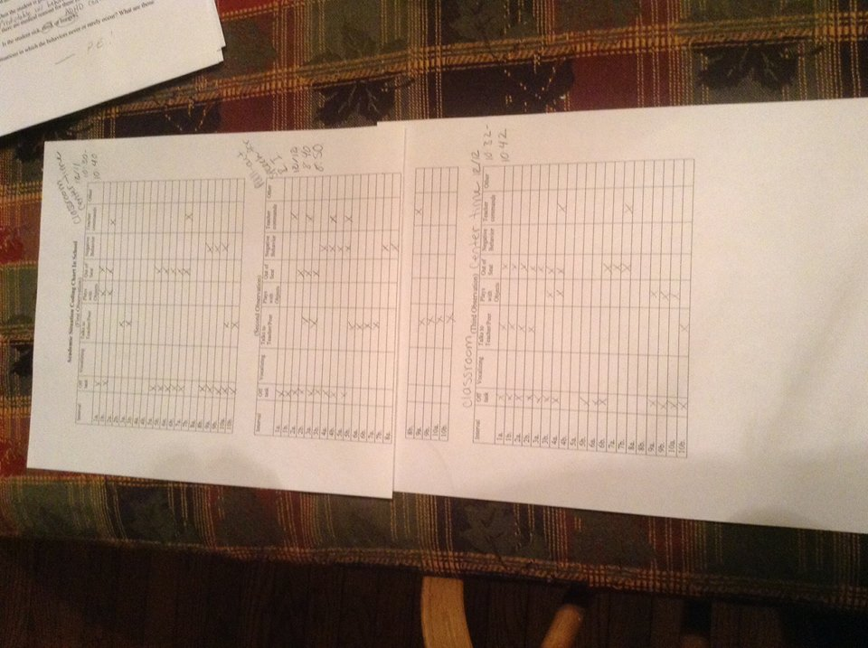
Appendix A-Observational Data

Slide 34
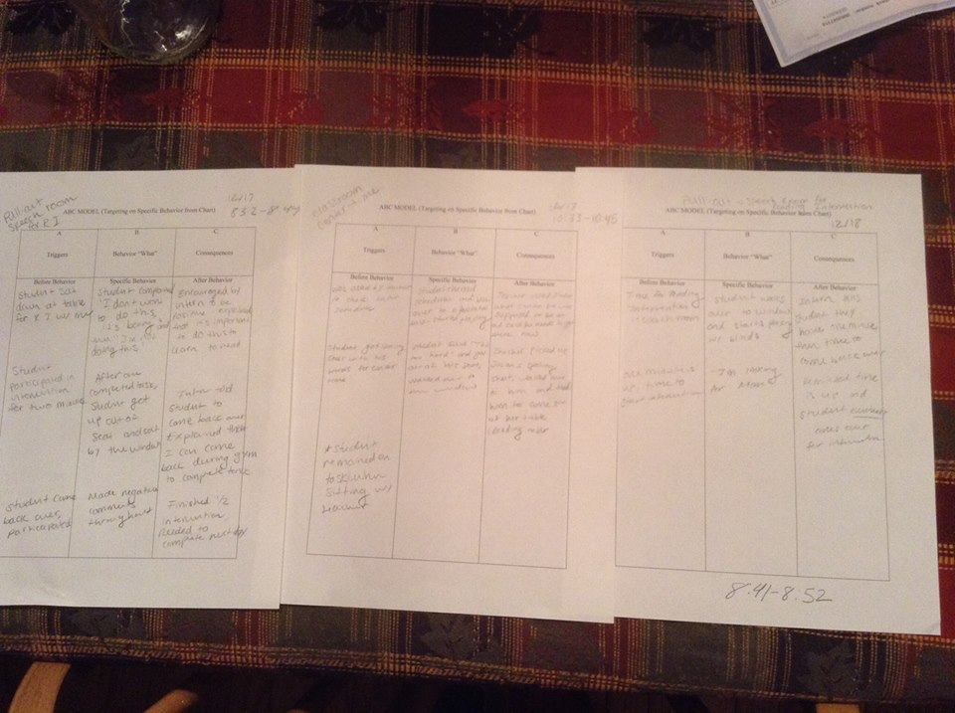
Appendix B-ABC Models

Slide 35
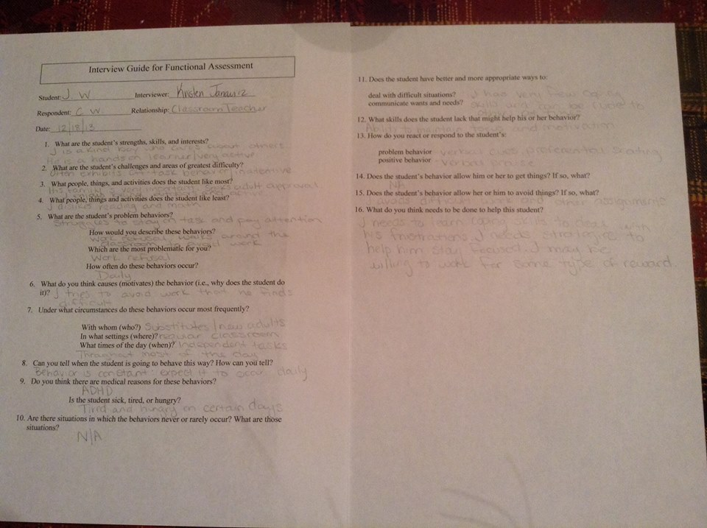
Appendix C-Interview #1

Slide 36
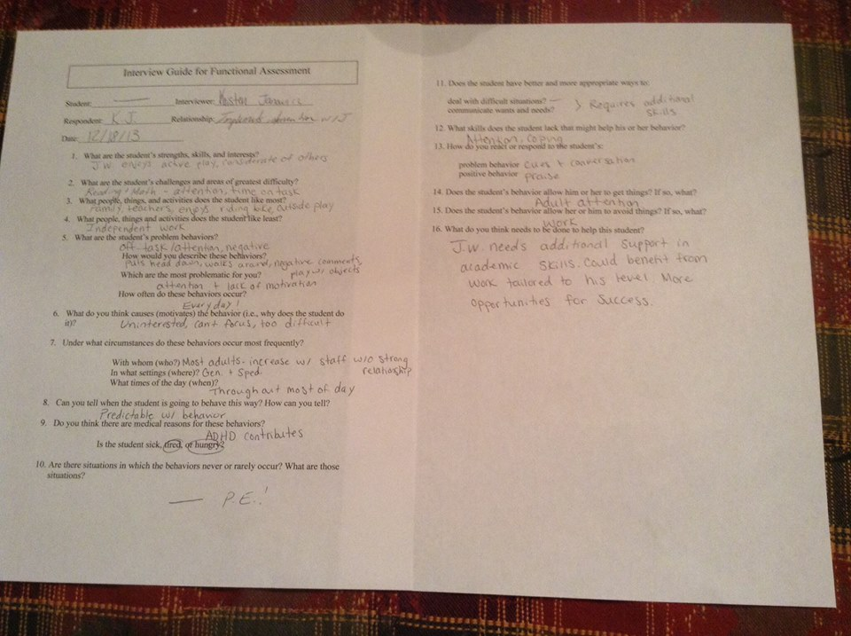
Appendix D-Interview #2

