Slide 1

Student Financial Services
Open House Presentation
Notes:
Welcome to PSU!! And, thank you for joining us to talk about financial aid.
How many of you are sophomores? Juniors? Seniors?
And, how many of you are anxious about the financial aid process? Well, you are not alone. We are all in this together!!
The PSU Financial Aid Team will be your partner through this process.
The best thing you can do is educate yourself by taking advantage of educational opportunities such as this!
So, let’s get started and talk about the seven important steps in the financial aid process.

Slide 2
How to Apply for Financial Aid
File the FAFSA (Free Application for Federal Student Aid) at studentaid.gov The FAFSA is a FREE federal application that initiates the financial aid process and is the only application PSU uses to determine eligibility for Financial Aid
2023-2024 FAFSA requires student and parent information and uses 2021 Federal Tax Information.
Submit any information requested (via fax, mail or our secure Dynamic Forms upload tool) to PSU as soon as possible
Keep an eye on incoming emails (both the student and parent listed on the FAFSA will receive emails)
Once we receive notification you have been accepted to PSU and review all documentation submitted, a final financial aid offer will be sent
Notes:
At PSU only one financial aid application is required and that’s the FAFSA form.
FAFSA stands for Free Application for Federal Student Aid.
Explain the IRS Data Retrieval tool and why it might save them time down the line.

Slide 3

I have my financial aid offer but what is Financial Aid?
Simply put financial aid is money to
help students pay
for college
Financial Aid consists of:
  Grants & Scholarships
  Loans
  Work Study
Notes:
At PSU only one financial aid application is required and that’s the FAFSA form.
FAFSA stands for Free Application for Federal Student Aid.
Explain the IRS Data Retrieval tool and why it might save them time down the line.

Slide 4
Federal
  Pell Grant
  2023-2024 awards range from $767 - $7395
  Based on Estimated Family Contribution (EFC) from FAFSA
  Federal Supplemental Educational Opportunity Grant (FSEOG)
  Also Based on EFC
State
Unique Endowed and Annual Funds
Must be Pell grant eligible
Based on FAFSA filing date and EFC
PSU Grants
Based on eligibility and FAFSA filing date
Grants
Notes:
At PSU only one financial aid application is required and that’s the FAFSA form.
FAFSA stands for Free Application for Federal Student Aid.
Explain the IRS Data Retrieval tool and why it might save them time down the line.

Slide 5
Scholarships
PSU Merit Scholarships
Awarded through the Admissions Office
Based on academic strength, major, talent
Granite Guarantee
Available to NH Residents
Must be eligible for the Federal Pell Grant
FAFSA filed on-time (by March 1)
Maintain good academic standing
Tuition covered by a combination of institutional, federal & state scholarships and grants
Additional PSU Awards
Bay and Ocean States Scholarship - Available to full-time Massachusetts or Rhode Island students
North Woods Connection - Available to full-time Maine or Vermont students
Tri-State Scholarship - Available to full-time Connecticut, New York, or New Jersey students
STEM Scholarship
Notes:
We are now pleased to announce that we will be participating the Granite Guarantee. Review the slides.

Slide 6

Other Scholarships
Apply for as soon as possible
High School Guidance Office
Local library resources
Local businesses, civic organizations, churches, private companies
Parent/Guardians’ OR Student’s place of employment
Scholarship search engines
(Fastweb.com, collegeboard.org, etc.)
NH Charitable - www.nhcf.org

Slide 7

Federal Student Loans
Must file FAFSA
Student is the borrower
May be a mixed of Subsidized and Unsubsidized
$5,500 first year, $6,500 second year, $7,500 additional years
2022-2023 interest rate 4.99%; with 1.057% origination fee
Student must complete extra steps to acknowledge they want to accept student loans.
    Master Promissory Note - Electronically signed documents promising to repay the loan
    Entrance Counseling – Online tutorial reviewing how the loan works
Notes:
We are now pleased to announce that we will be participating the Granite Guarantee. Review the slides.

Slide 8
Optional Loans
Federal Parent PLUS Loans
Parents apply
Based on credit
If parents are denied loan, the student can receive $4000 (1st & 2nd year) or $5000 (3rd +) in additional Federal Direct Unsubsidized Student Loan
2022-2023 interest rate is 7.54%; with 4.228% origination fee
Alternative Private Loans
Anyone can apply
Different lenders have different interest rates and repayment terms
Notes:
We are now pleased to announce that we will be participating the Granite Guarantee. Review the slides.

Slide 9

Work Study and Student Employment
Work Study
Need based
Jobs on Campus
Meet Eligibility Criteria
Funding comes from government instead of
department budget
Hourly Student Employment
Not based on need
On and Off-Campus Part-Time Jobs
Notes:
At PSU only one financial aid application is required and that’s the FAFSA form.
FAFSA stands for Free Application for Federal Student Aid.
Explain the IRS Data Retrieval tool and why it might save them time down the line.

Slide 10
Percy Jackson
21 Poseidon Blvd
Mt Olympus, NH 03264
Dear Percy,
Congratulations on your acceptance to Plymouth State University! We have completed our review of your financial aid application materials for the 2023-2024 academic year and your offer appears below. Please refer to the enclosed Financial Aid Guide and our website at go.plymouth.edu/aid for information regarding your aid offer, financial aid policies, maintaining financial aid eligibility, and options for paying your balance. Your financial aid package is based upon an Expected Family Contribution (EFC) of 9889, enrollment status of full-time, and a housing status of campus housing.
ESTIMATED Annual Cost of Attendance (Resident)
Direct Billed Costs | Fall | Spring | Annual
Tuition and Fees | $7,279 | $7,279 | $14,558
Housing and Food | $6,053 | $6,053 | $12,106
Orientation and Enrollment Fees Total Annual Direct Bill Costs | $256 | $0 | $256 $26,920
Financial Aid Offer
Scholarships and Grant Promise Award University Grant | Fall $1,500 $2,900 | Spring $1,500 $2,900 | Annual $3,000 $5,800
Loans Federal Direct Subsidized Loan Federal Direct Unsub. Loan | $1,750 $1,000 | $1,750 $1,000 | $3,500 $2,000 __________
Total Financial Aid Offer |  |  | $14,300
Your ESTIMATED Annual Out-of-Pocket Expense
How much will you need to pay PSU? -Direct Billed Costs, $26,920 less Financial Aid Offered, $14,300 | $12,620
Notes:
Every school that participates in the Federal Title IV Educational programs is required to have a net price calculator that is at least within at least three clicks of their website. Our’s has now been updated to reflect the 2018-19 academic year estimated costs and awarding. We encourage all of you to check out these links and complete the process!

Slide 11
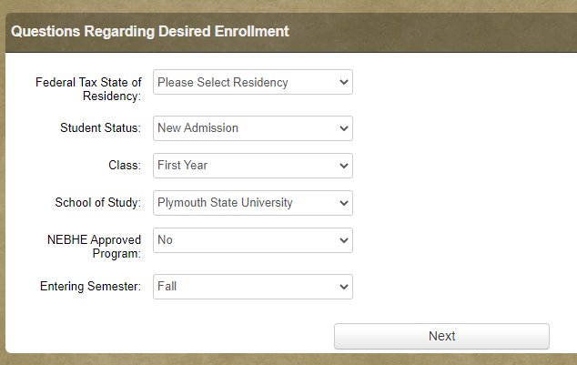
Bill Estimator
https://www.plymouth.edu/webapp/college-calculator/
Notes:
Every school that participates in the Federal Title IV Educational programs is required to have a net price calculator that is at least within at least three clicks of their website. Our’s has now been updated to reflect the 2018-19 academic year estimated costs and awarding. We encourage all of you to check out these links and complete the process!

Slide 12
Options for Funding Your Education
1: Direct Payment by cash, check, 529 college savings plan,
outside scholarships, etc
2: Monthly installment payment option. This is not a loan program so there are no interest payments. The installment plan allows you to take existing resources and pay them over a six month period.
Fall 2023 Payment Plan opens April 1 – First payment is due May 1st.
3: Federal Direct Parent Loan for Undergraduate Students (PLUS) is a fixed-interest rate loan in the parent’s name that is base on credit. If parents are denied the loan, the student can receive $4000 (1st & 2nd year) or $5000 (3rd +) in additional Federal Direct Unsubsidized Student Loan. The 2022-2023 interest rate is 7.54% with 4.228% origination fee. Additional information can be found at go.plymouth.edu/plus.
2023-2024 Application opens at studentaid.gov April/May
4: Alternative/Private Loans are private loans through a third party lender. Different lenders have different interest rates and repayment terms. Additional information can be found at go.plymouth.edu/alternative.
Note: A combination of the options above may be used.
Notes:
Every school that participates in the Federal Title IV Educational programs is required to have a net price calculator that is at least within at least three clicks of their website. Our’s has now been updated to reflect the 2018-19 academic year estimated costs and awarding. We encourage all of you to check out these links and complete the process!

Slide 13
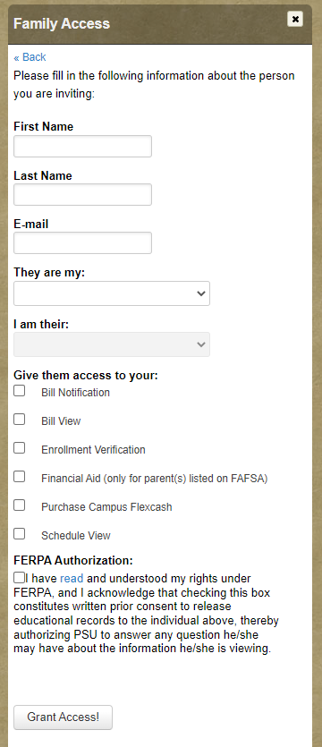
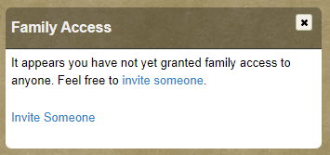
Important Billing Information:
PSU bills per semester and bills are only available online.
Bills can be found on the ‘Services’ tab of the student’s
myPlymouth portal.
Semester Bill Avaiable Bill Due Date
Fall 2023 Early July Aug 4, 2023
Spring 2024 Early November Dec 1, 2023
Family Access
Due to federal regulations we can only discuss specifics of the bill with the student and anyone to whom they have granted ‘Bill View’ in Family Access. This can be found on the welcome tab of your myPlymouth
Notes:
Every school that participates in the Federal Title IV Educational programs is required to have a net price calculator that is at least within at least three clicks of their website. Our’s has now been updated to reflect the 2018-19 academic year estimated costs and awarding. We encourage all of you to check out these links and complete the process!

Slide 14
Remember…
In most cases, families will have financial responsibility. Discuss costs and options as a family.
The earlier you start with the process, the better.
PSU will review your FAFSA to determine aid once you are accepted to the University
Visit the school website for information about the financial aid process and requirements (go.plymouth.edu/aid)
Call or email us with any questions or concerns
Financial Aid decisions are sent on a rolling basis
Notes:
Every school that participates in the Federal Title IV Educational programs is required to have a net price calculator that is at least within at least three clicks of their website. Our’s has now been updated to reflect the 2018-19 academic year estimated costs and awarding. We encourage all of you to check out these links and complete the process!

Slide 15

Contact Information
Student Financial Services
17High Street, MSC 19
Plymouth, NH 03264
go.plymouth.edu/aid
psu-sfs@plymouth.edu
P 603-535-2338
F 603-535-2627

